Slide 1
Removal of the
Boone County Auditor
October 6, 2026

Slide 2
Legal Process
The Commissioners and Council must file a petition with the court.
  A judge would ultimately decide whether removal is appropriate.
Before that petition can be filed, the Commissioners and Council must each first consider a resolution in a public hearing.
  That resolution “must contain a concise statement of the underlying basic facts that support a finding that the county officer committed a violation.” I.C. § 36-2-8.7-2.
    The Commissioners and the Council do not vote on the resolution at today’s hearing.
    Each Board will meet at a later date to vote.

Slide 3
Resolution
Both Boards have a copy of a proposed resolution for consideration.
Resolution identities 22 different issues for you to consider.
Do the issues support a finding that the Auditor is guilty of “refusing, neglecting, or being unable to perform the official duties pertaining to [her] office.”
  Submit that not all of the issues I could have raised.
  These are most egregious examples of Auditor’s refusal to perform or her neglectful performance of her job.

Slide 4
Auditor’s Official Duties
Financial recordkeeping – Documenting all financial activity in the county’s funds and reporting annually to the state’s Gateway System
Account maintenance – Keeping accurate accounts for each appropriation, reconciling with the county treasurer, and maintaining current records
Payment and claims – Issuing warrants, certifying claims and processing payments in accordance with Council approval
Property tax process – Preparing, preserving, and maintaining the tax duplicate for property tax administration
Clerk duties – Serving as clerk at meetings for the county commissioners and county council
Internal controls – Implementing and maintaining compliance with SBOA’s Uniform Internal Control Standards, covering control environment, risk assessment, control activities, information/communication, and monitoring

Slide 5
Private/Confidential Information
3 examples
  DCS incident
  Councilwoman Hostetter’s W2
  Unsecured email to co-worker

Slide 6
Department of Child Services Incident
May 20, 2026 (3:37 pm) –Joy Myers (DCS) emailed Crum
  The Financial Quality Assurance (FQA) Dept with the Child Support Bureau is starting audit (reviewing county offices that utilize federal IV-D funds)
  May 20 (7:59 pm) - Email read by Crum and ignored.
May 28, 2026 (11:14 am) – Myers sent a follow up email to Crum
June 3 (8:35 am) – [12 days after initial email]
  Crum sent 2026 payroll calendar and services agreement with Maximus;
    Maximus agreement signed by Crum on 5/5/25 (not approved by Commissioners)
June 3 (9:37 am) – sent payroll and budget reports
  Clerk’s Office, Prosecutor’s Office, and Circuit Court only

Slide 7
Department of Child Services Incident - Continued
Between June 8 and June 24: several emails were exchanged between Crum and DCS with DCS asking questions and Crum responding.
June 29 (8:32 am): Myers emailed Crum and asked, “please send me a copy of the deduction register showing the County paid LTD amounts.”
June 29 (2:49 pm): Crum emailed her “the deduction register for the LTD the county pays on behalf of the employee.”
June 29 (3:40 pm): Myers replied, “Thank you for sending the PR Deduction Register. However, the check are all for 2025 and, none of the employees that I am reviewing are on it. I have attached a list of the employees that I am reviewing. Did I receive the wrong list?”

Slide 8
Department of Child Services Incident Continued
June 30 (8:12 am): Crum emailed Amber Choate and asked, “Can you print me a report showing all employees that are enrolled in LTD that the county pays on behalf of the employee, please.”
June 30 (8:14 am): Choate responded, “Yep! It is all full-time and I will stick it in the drive. Do you want a total on it too for 2027 anticipated budget?”
June 30 (8:25 am): Choate followed up, “I placed it in the drive. If you scroll over to column V and down to row 292-293, you will see the per pay period amount along with the annual contributions. We do still have a few Sheriff new hires that have not enrolled yet so there will be a few additional. Let me know if you need anything else!”
June 30 (9:15 am): Crum responded to Choate, “Thank you!”

Slide 9
Department of Child Services Incident Continued
June 30 (9:25 am): Crum emailed Myers, “Sorry, I ran the report for 2025. Here is the correct report and elected officials are not of the employee paid LTD. If an elected official chooses to have LTD, they have to pay for it. Lisa Bruder and Sally Berish did not choose to take LTD.”
  She did not attach the list on this email.
June 30 (9:48 am): Myers responded to Crum, “think you forgot to attach the report. Please do not hesitate to contact me should you have any questions.”
June 30 (10:08 am): Crum emailed her the list with 290 employees and SSNs.
July 15 (9:19 am): Myers emailed Debbie and asked a follow-up question regarding LTD (list with SSNs on that email)
  Debbie ignored it. As a result, Myers forwarded the email to others to get a response on July 21.

Slide 10
Why is this a big deal?
Email trail proves:
  Auditor ignored and was nonresponsive with DCS multiple times during audit
  She provided the wrong documentation to DCS
  She sent emails claiming to provide documentation and did not
  She knew audit only impacted Clerk’s Office, Prosecutor’s Office, and Circuit Court
    In fact, she had the names of the 12 employees.
  Yet, she requested a document with ALL employees on it.
  She did not provide any context to HR, who reasonably believed seeking information to prepare for 2027 budget
  Then, she just attached the list (which had been placed on a secured county drive) without reading it.
County Director of Administration and County Attorney notified on July 22
No acknowledgment of mistake or accountability
Lied about timeline of events with DCS
Blamed Human Resources
Not until notified that pursuing removal was there an acknowledgment of fault.

Slide 11
Why else is this a big deal?
Two other instances where negligently emailed social security numbers via unsecured email:
  On March 7, 2024, emailed Councilwoman Hostetter’s W9 to unauthorized persons.
  On July 1, 2024, emailed several lists to co-worker. List included personal identifiers for dependents.
    Both provided to County Attorney in unrelated public records request.

Slide 12
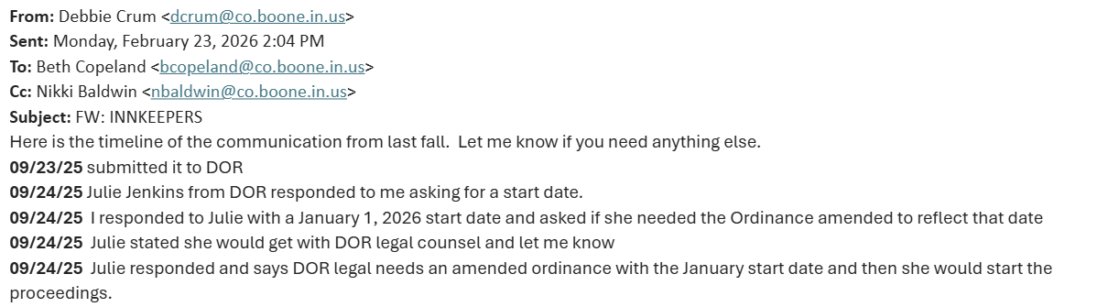
Innkeeper’s tax issue
In September 2025, Council adopted a new Innkeeper’s Tax rate to increase it from 5% to 8%. Per Indiana law, that ordinance went into effect on October 1, 2025.
Did not ask County Attorney or Council’s Attorney

Slide 13
Why is this a big deal?
The 3% uncollected for 3 months was approximately $155,699.07 in lost taxes to the County.
Still attempting to recover approximately $43,342.21 in back taxes owed due to her negligence.
Substantial impact on the Tourism Commission, hotel owners, and other county employees.

Slide 14
Worker’s Compensation Issue
Walker Hughes works with County.
Needs correct payroll information to populate worker’s compensation rates for insurance.
Auditor does not communicate with Walker Hughes or provide documentation.
  Simple sharing of approved salary ordinance.
Worker’s compensation carrier annual audit has resulted in additional premiums:
  Years 2022-2023 (pay 2024) = $46,227.00;
  Years 2023-2024 (pay 2025) = $74,923.00; and
  Years 2024-2025 (pay 2026) = $63,531.00
November 2025 – Commissioners discovered property and casualty insurance fund was mysteriously low.
Required to do a reappropriation to pay remaining expenses in 2025.
Auditor never spoke up. [She paid Walker Hughes the extra $74,923.00 in February 2025].

Slide 15
Positive Pay Issue
  3,754 total checks have been flagged by KeyBank.
  The County is charged $4.00 per check for each that has to be validated.
January = 289/$1,156.00 | February = 570/$2,280.00 | March = 210/$840.00
April = 153/$612.00 | May = 347/$1,388.00 | June = 594/$2,376.00
July = 612/$2,448.00 | August = 418/$1,672.00 | September = 561/$2,244.00

Slide 16
Why is this a Big Deal?
  This repeated failure has cost the County approximately $15,016.00 in 2026.

Slide 17
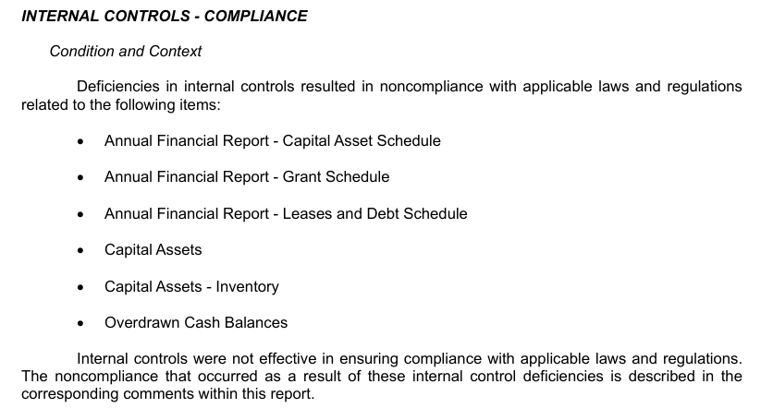
Lack of Internal Controls
Since at least 2022, the SBOA has identified the Auditor’s lack of Internal Controls as a significant issue during its annual audits.
From the 2025 report (released Aug. 2026):

Slide 18
Lack of Internal Controls
Specific examples of problems in the July 2025 audit report:
“Due to the lack of internal controls, the financial statement presented for audit included the following errors:
The County Sheriff's Cash Book was included in the financial statement, which overstated both receipts and disbursements by $2,916,572.
The Clerk of the Circuit Court’s ISETS fund overstated receipts by $9,193, overstated disbursements by $6,017, and overstated the ending balance by $3,176.
The 93.563 Pros IV-D Inc PST 10/99 fund overstated both receipts and disbursements by $8,170.
The 93.563 Clrk IV-D Inc PST 10/99 fund overstated both receipts and disbursements by $13,143.
The Opioid Restricted Fund understated receipts by $24,009, and the Opioid Unrestricted Fund overstated receipts by $24,009.

Slide 19
Lack of Internal Controls - continued
October 2022: According to Baker Tilly, Auditor requested they prepare a draft of proper Internal Controls for her office.
  Those Internal Controls were drafted, finalized and emailed to the Auditor/Treasurer on June 14, 2023 for review and feedback. – no response
  On July 12, 2023, Baker Tilly followed up and asked whether either had any questions or comments on the proposed draft. – no response
    Baker Tilly believed Internal Controls project was completed.
    These Internal Controls were never presented to, approved, or adopted by the Commissioners and never implemented by the Auditor.
  Baker Tilly billed the County for this work. County paid = $34,434.61

Slide 20
Lack of Internal Controls - continued
  In early 2026, the Commissioners released a Request for Proposals to access Internal Control deficiencies in the Auditor’s Office that have been repeatedly called out by SBOA, so proper Internal Controls can finally be adopted by the County.
  As part of this 2026 audit, Auditor provided a copy of her alleged “Internal Controls Financial Software”
    Basic, nondescript, two-page document with no date of adoption on it.

Slide 21
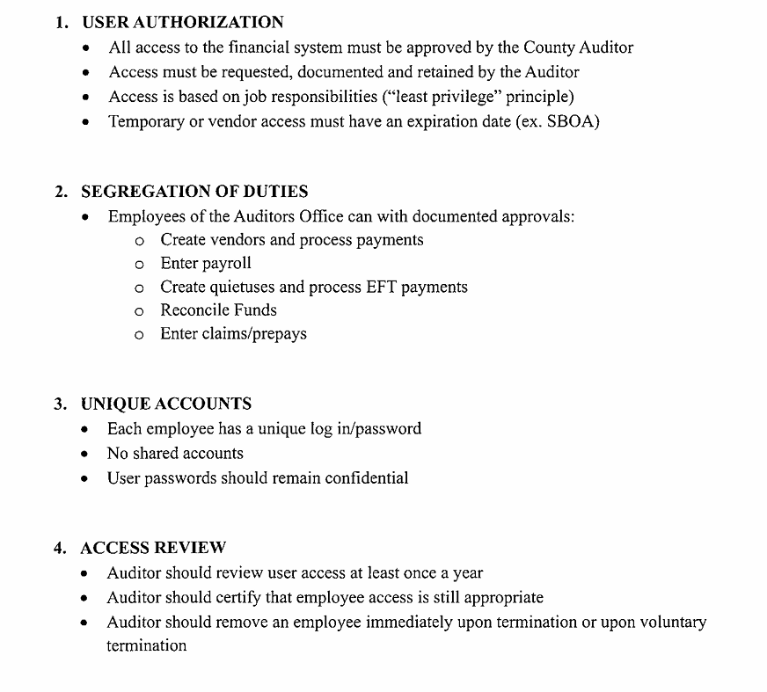
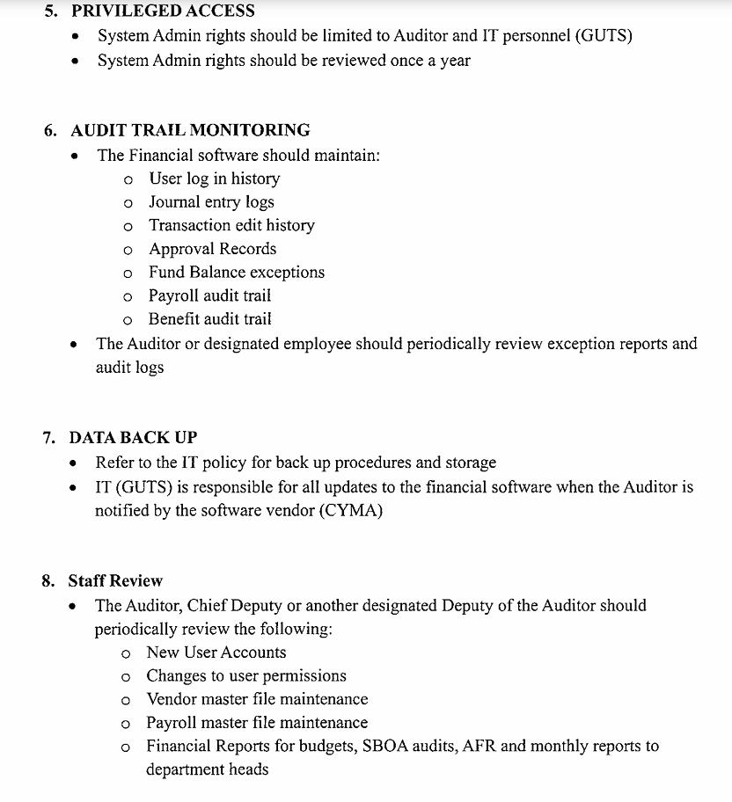

Slide 22
Why is this a big deal?
  Every year in office, SBOA marks Auditor’s lack of internal controls as a substantial problem.
  A lack of internal controls hinders the County’s accuracy, transparency, and accountability of public funds.
  Lack of internal controls has caused significant payroll problems for County.
  Spent $34,434.61 on Baker’s Tilly’s draft
  Failure to adopt and follow Baker Tilly’s draft cost County $51,300.00 in 2026 for newest audit.

Slide 23
FINANCIAL SOFTWARE Issues
The Auditor has unreasonably and without notice eliminated access to employees, including other elected officials, to CYMA—several of whom have a legitimate business need to access (read only) the County’s financial software to perform their jobs.
The Auditor is provided all user names and passwords for all County employees/elected officials who have CYMA access.
  This violates her own policy.

Slide 24
Payroll Issues
Appears to be a significant issue
  Unclear just how significant
  SBOA “tested” segment of Auditor’s payroll
    6 out of 16 employees – 1/3 of test group
    Reasonable to assume roughly 1/3 of all employees have payroll problems?
Pages of problems in the Resolution, which is a small sample of personnel.
Examples include:
  Pay periods with miscalculations of insurance premiums
  Social security and Medicare incorrectly calculated
  Errors in dental premiums
  Errors in Hoosier START deferred compensation plan.
  HSA contributions not made.
  Employees overpaid
  Life insurance premiums incorrect
SBOA stated some issues were not caught by Auditor
  How many pay periods were there problems?

Slide 25
Payroll issues - continued
Significant issues with PERF
One example:
An employee began employment with the County in a PERF eligible role in June 2024, but the Auditor did not make PERF contributions until January 2025. The Auditor submitted an adjustment to PERF in January 2025 to contribute $4,350 in contributions missed during 2024. The pay period ending December 29, 2024, which was paid on January 10, 2025, was not included in this adjustment. Therefore, the employee’s PERF contributions were underpaid by $294.
Evidence that PERF paid late for all employees on occasion.
Additional evidence that PERF paid weeks/months late for some employees on occasion.
  Employees not told. Can only find out if call PERF.
  Missed or delayed payments directly impacts employee retirement benefits. Impossible to calculate loss on compounding interest.

Slide 26
Why is this a big deal?
Really?

Slide 27
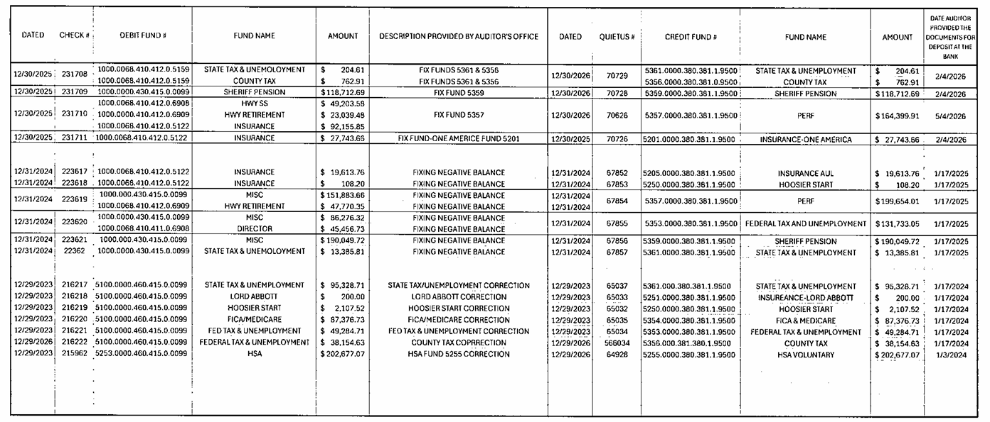
Negative Payroll Issues

Slide 28
Negative payroll issues - continued
3 “MISC” transactions from 1000.000.430.415.0.0099
Believe that is the General Fund.
Is that unappropriated money (i.e. never approved by Council)?
All done on 12/31/24 to “fix negative balance” for following funds:
  PERF
  Federal Tax and Unemployment
  Sheriff Pension
$428,209.70 – moved without Council approval?

Slide 29
Negative payroll issues - PERF
2025
Actual payroll = $1,730,785.75
Payments to PERF in payroll = $2,090,028.79
Payments to PERF outside payroll = $28,787.54
Total = -$388,030.58
2026
So far = -$230,000.00 (approximately)

Slide 30
Why is this a Big deal?
Because it violates the law.
IC 36-2-9-13:
(b) The auditor may not permit an item of appropriation to be overdrawn OR to be drawn on for a purpose other than the specific purpose for which it was made.
(c) An auditor who knowingly violates this section commits a Class A misdemeanor.

Slide 31
Open Door Law Violations
Issue 1: I.C. § 5-14-1.5-5
Law requires a notice posted at least 48-hours before a public meeting.
None of Council’s August 2026 workshops/public meetings were noticed.
Issue 2: I.C. 5-14-1.5-2.9
Law requires all Council meetings be livestreamed.
None of Council’s August 2026 workshops/public meetings were livestreamed.
Simple mistake? Perhaps. But then why lie about putting the notices in the newspaper?

Slide 32
More open door law violations
Issue #3: I.C. § 6-1.1-18-5
(a) If the proper officers of a political subdivision desire to appropriate more money for a particular year than the amount prescribed in the budget for that year, they shall hold a public hearing after submitting the following information regarding the proposed additional appropriation to the department's computer gateway:
(1) The amount of the additional appropriation.
(2) The name of the affected fund.
(3) The name and account number of the affected account.
(4) The date, time, and place at which the political subdivision or appropriate fiscal body will hold a public hearing on the proposed additional appropriation.
The Auditor did not advertise any public hearings held by Council on additional appropriations between January 2025 and August 2025.
What was reported to DGLF?

Slide 33
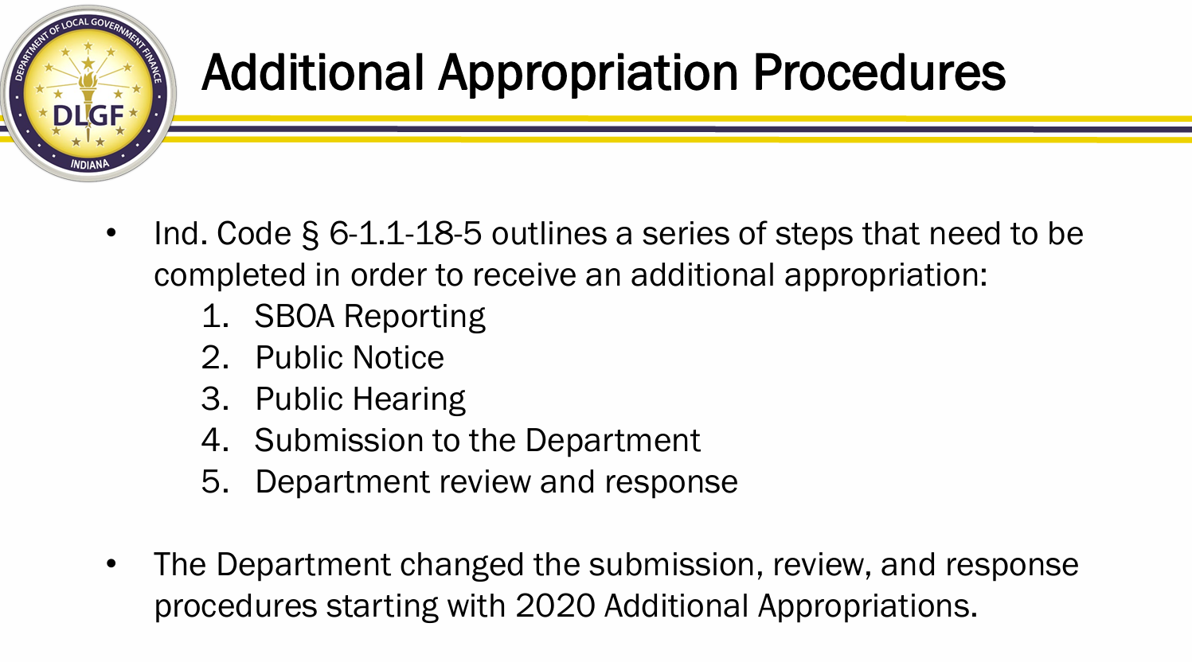

Slide 34
Why is this a big deal?
Violates several laws: I.C. § 5-14-1.5-5; I.C. 5-14-1.5-2.9; and I.C. § 6-1.1-18-5
She is the Clerk of the executive and fiscal bodies.
  Responsible for ensuring compliance with Open Door laws.
These are direct examples of her failure to perform an act required by law (i.e. it’s nonfeasance).
Researching whether misrepresented anything to DLGF.

Slide 35
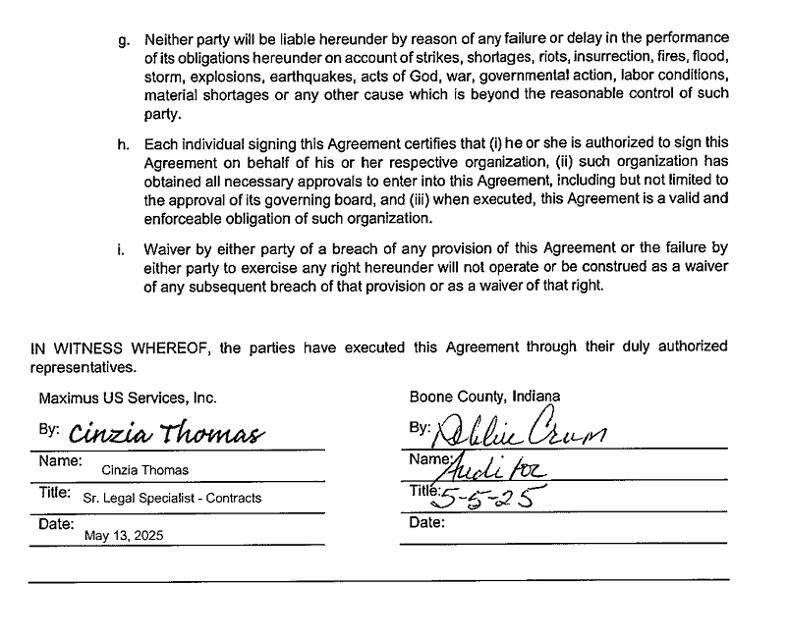
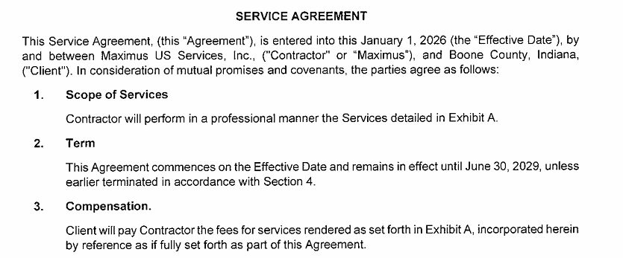
Signed A Contract Without Following Legal Process

Slide 36
Why is this a big deal?
Violates I.C. § 36-2-2.9 ​
There is a statutory process for the approval of all non-judicial branch county contracts.
Commissioners did not review or approve this contract.
Legal did not review or approve this contract.
Commissioners have the authority to void the contract because she did not follow correct legal process.
Misrepresentation to Vendor
Found by Accident​
This contract was discovered by accident during the investigation into the DCS/social security breach issue in July 2026.
How many others are there?
Paragraph H represents that the individual signing it has the authority to sign it and obtained all necessary approvals.

Slide 37
Additionals/Reappropriations Without Council Approval
Impossible to know full scope without an in-depth evaluation of records
Money moved year-end without notice, public hearing, or Council approval
Money moved throughout the year without notice, public hearing or Council approval
  March 11, 2025 meeting
    2 additional requests on agenda (not advertised)
      Sheriff/Misdemeanant = $45,000
      Highway/Local Road & Bridge = $48,862.35, $194,388.73, and $724,278.88
    Ledger identifies “Addt’l Per Council” on 3/11/25 = not approved by Council
      $20,017.96 and $95,395.53

Slide 38
Why is this a big deal?
Because it violates the law.
IC 36-2-9-14 Drawing of warrants; necessity of appropriation; violation; offense
(c) A warrant may be drawn on a county treasury only if the county fiscal body has made an appropriation for the money for the calendar year in which the warrant is drawn and that appropriation has not been exhausted.
(e) An auditor who knowingly violates this section commits a Class A misdemeanor.
Intentional deception? Auditor has represented on the County’s ledgers that an additional appropriation was done “per Council,” when in fact, Council never considered or approved the request.

Slide 39
Failure to Pay Federal Wage/Social Security Withholdings
Did not remit payroll withholdings to the IRS.
  From the time she took office in March 2020 to January 2024, the Auditor missed timely filing several Employer’s Quarterly Federal Tax Returns (Form 941) with the IRS.
  On January 30, 2024, the Auditor finally paid back taxes owed, plus penalties and interest that had accrued, to the IRS in the total amount of approximately $148,026.03.
    That payment was made from an “unappropriated line” in Fund 5353.

Slide 40
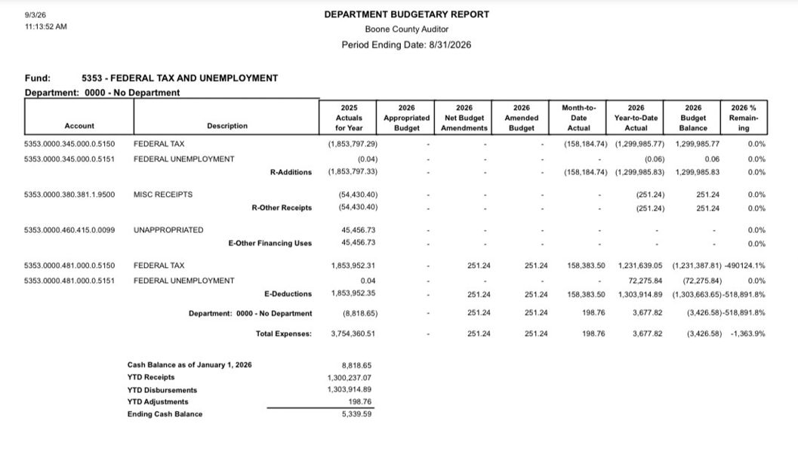
Fund 5353

Slide 41
Why is this a big deal?
    How was money transferred into an “unappropriated line” in Fund 5353?
    Dollars are never appropriated to that Fund by Council.
      Believe that $54,430.30 moved from UMR Claim Reimbs
    Therefore, believed this is an expenditure of dollars without Council approval in violation of Indiana Code section 36-2-9-14(c).
    IC 36-2-9-14 Drawing of warrants; necessity of appropriation; violation; offense
    (c) A warrant may be drawn on a county treasury only if the county fiscal body has made an appropriation for the money for the calendar year in which the warrant is drawn and that appropriation has not been exhausted.
    (e) An auditor who knowingly violates this section commits a Class A misdemeanor.

Slide 42
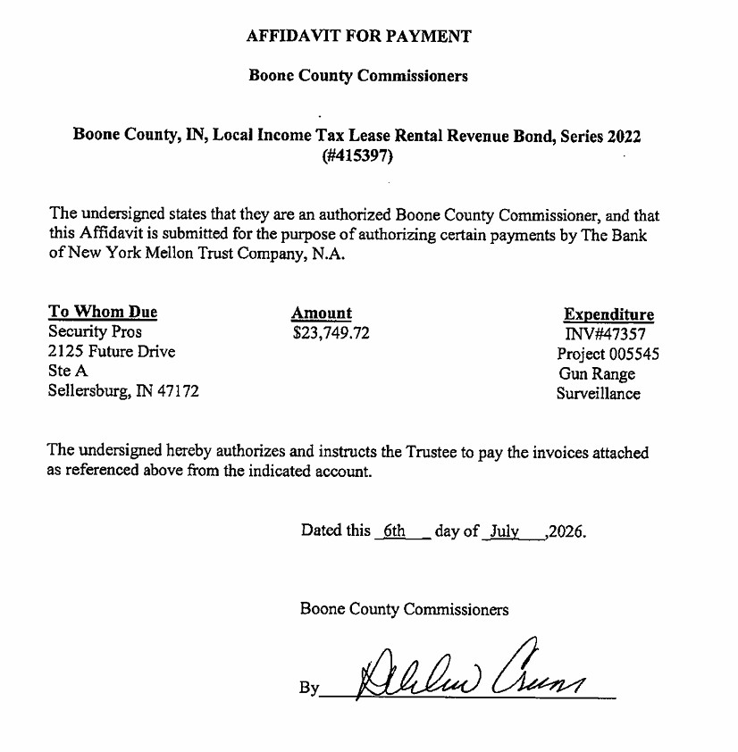
Signed Affidavits as a Commissioner
In July 2026, the Auditor signed 4 affidavits affirming she is an “authorized Boone County Commissioner.”
She is not.

Slide 43
Not Uploading Contracts
Between March 27, 2019* and February 25, 2025, the Auditor uploaded zero contracts to Gateway.
After almost 5 years into office, she uploaded 12 contract to Gateway (on February 25, 2025).
Since February 25, 2025 = none.
  Just in 2026, the Commissioners have approved approximately X contracts.
*It is believed the Auditor took office on March 7, 2020.

Slide 44
Why is this a big deal?
IC 5-14-3.8-3.5:
Fiscal Officer is required to upload a digital copy of a contract to the Indiana transparency website (i.e. Gateway) one (1) time if the total cost of the contract exceeds $50,000 during the term of the contract.
  Only exception is if employment contract between Boone County and an employee.
This must be done not later than sixty (60) days after the date the contract is executed.
This is one of her official duties.

Slide 45
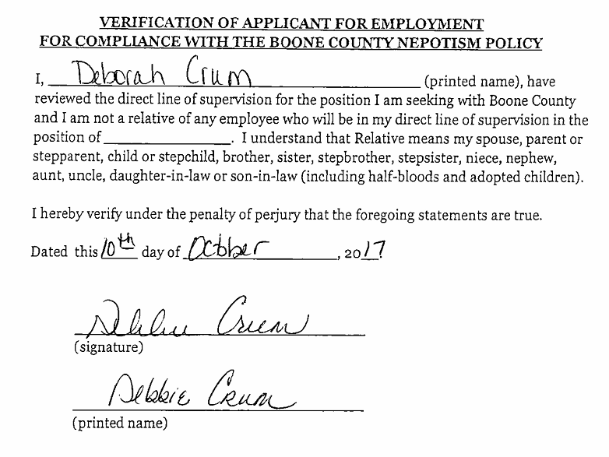
Nepotism Issue
In 2023 and 2024, the Auditor directly hired and paid her daughter to work for the County.

Slide 46
Why is this a Big Deal?
Because it violates the law.
IC 36-1-20.2-10 Employment of relatives in direct line of supervision prohibited
Individuals who are relatives may not be employed by a unit in a position that results in one (1) relative being in the direct line of supervision of the other relative.

Slide 47
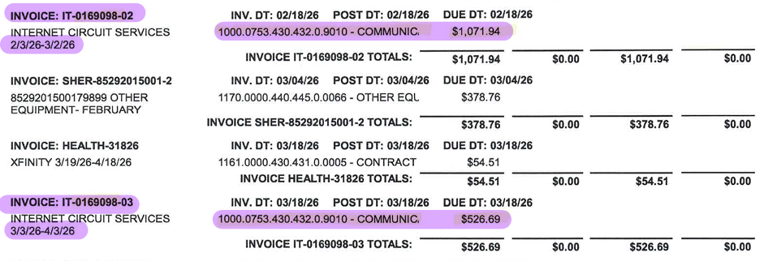
Paying Invoices from Wrong Funds/Lines
Baker Tilly Invoice
  $3,072.75 was paid to Baker Tilly for work performed between 12/5/22 and 3/7/2025
  Invoice dated 4/7/2025
  Bill paid on 4/8/2026
  Paid from 1000.0068.430.431.0.0001 – Legal Servs line
Comcast Invoice
  Comcast turned off at jail in August 2026
  Discovered Auditor paid Comcast invoices from GIS fund (1000.0753.430.432.0.9010) in February, March, April and July. *May and June were not paid at all.
  Supposed to be paid in Fund 9098.

Slide 48
Why is this a big deal?
Because it violates the law.
IC 36-2-9-13 Appropriations by county fiscal body; accounting; warrants; violation; offense
(b) The auditor may not permit an item of appropriation to be overdrawn or to be drawn on for a purpose other than the specific purpose for which it was made.
(c) An auditor who knowingly violates this section commits a Class A misdemeanor.

Slide 49
Refusal to Use Approved County Software
The Auditor refused to use Neogov for several years, even though the platform was approved by the Commissioners and funded by the Council.
She expressly communicated to another elected official, “I am not using Neogov. [HR] cannot make me use this for payroll” on October 18, 2024.

Slide 50
Encumbrances Without Council Approval
Encumbrances are subject to Council approve.
Not done at the discretion of the Auditor.
February 2026 (for fiscal year 2025) first year Council approved.
Again, why do we care?
    IC 36-2-9-14 Drawing of warrants; necessity of appropriation; violation; offense
    (c) A warrant may be drawn on a county treasury only if the county fiscal body has made an appropriation for the money for the calendar year in which the warrant is drawn and that appropriation has not been exhausted.
    (e) An auditor who knowingly violates this section commits a Class A misdemeanor.

Slide 51
Where does all this leave us?
Do the facts in the Resolution support a finding that the Auditor is guilty of “refusing, neglecting, or being unable to perform the official duties pertaining to [her] office”?
If you believe yes = file a petition for a judge to consider her removal
If you believe no = this matter is concluded

Slide 52
Considerations
Removal process exists under the law for a reason.
Should only be used rarely = yes.
This is not just about the release of personal information.
Clear pattern of negligent performance in most every area she performs.
Do we expect her to be perfect? No.
Should we expect her to do her job in accordance with the law and well-established policies? Yes.

Slide 53

Questions?

